Slide 1
Scratchboard

Slide 2
Objective
Students will create a scratchboard artwork by scraping away black paint to reveal a colorful design

Slide 3
Objective
What are we creating?
We are creating a scratchboard artwork
What do we do to reveal a colorful design?
We scrape away black paint to reveal a colorful design.

Slide 4
Connection
This assignment uses multiple drawing techniques that involve a variety of line design to create value.
This lesson is building on the students’ skills of their fine motor skills by drawing strategically placed lines and assessing their understanding of value and space.
This project also incorporates the students prior knowledge of color schemes for the background colors of the piece.

Slide 5
Review
Value has to do with the lightness or darkness of something (black/shades and white/tints). Value is created within scratchboard art by using alternative techniques to drawing rather than rendering.
Drawing techniques can involve rendering, hatching, crosshatching, stippling, etc.
Space can be positive or negative – Positive space has to do with the object of an artwork while negative space has to do with the space that surrounds the object. Scratchboard focuses on a high contrast style between positive and negative space
Color schemes have to do with the arrangement of color within an artwork

Slide 6
Color Schemes
Analogous - A color scheme that consists of any three or four adjacent (next to) colors on the color wheel.
Monochromatic – A color scheme that is made from one single color mixed with black or white (tints and shades)
Complementary - Hues which are across from each other on the color wheel. (Opposite colors) *highest visual strength
Split-Complementary - A split-compliment color scheme includes a main color and the two colors on each side of its complementary (opposite) color on the color wheel.
Triad - Three colors spaced equally on the color wheel

Slide 7
grading
The projects must be complete
The lines are neat and intentional
The artwork is creative and original
The background colors must correspond with one of the color schemes

Slide 8
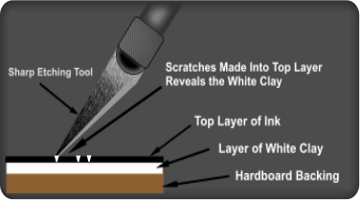
Scratchboard

Slide 9
Mini Scratchboard
Students will trace their 2 in / 2 in card onto a scratch paper three times
Students will draw a decorated letter (First or last name) within each of their three traced boxes.
This letter must look artistic, and not be a basic letter.
There must be some sort of embellishment (pattern or decoration) around the letter

Slide 10
Mini Scratchboard
Students will take a 2 in / 2 in paper and cover the paper using crayon.
The colors they select must be part of one of the color schemes learned from the previous assignment.
The card must be COMPELETLY covered in order for the assignment to be successful
Any areas that are left uncovered will not resist the paint

Slide 11
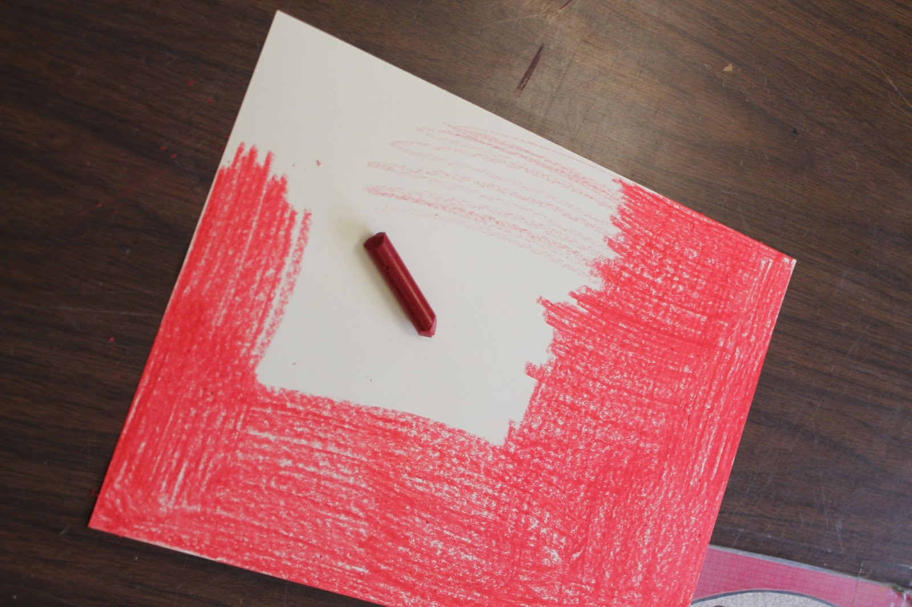
Scratchboard

Slide 12
Mini Scratchboard
Students will cover their papers with black tempera paint.
The tempera paint does not stick to the surface of the wax as well as it would stick to the pores of a paper.
This is called a wax resist style of creating art.

Slide 13
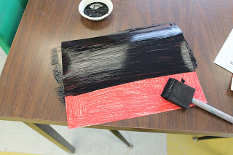

Slide 14
Mini Scratchboard
Looking at their sketched letters, we will select a letter and this letter will be drawn onto their 2 in / 2 in paper
Draw VERY LIGHTLY IN PENCIL to prevent accidental scratches from occurring
Upon completing their sketch, students will use a toothpick to scratch away the paint on the area they have drawn, revealing the color behind the paint

Slide 15
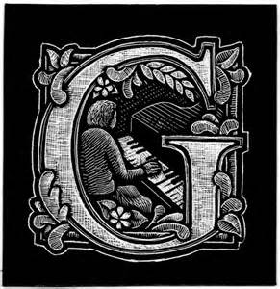

Slide 21
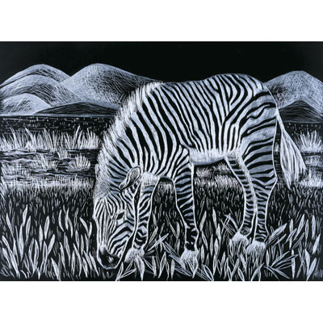

Slide 25
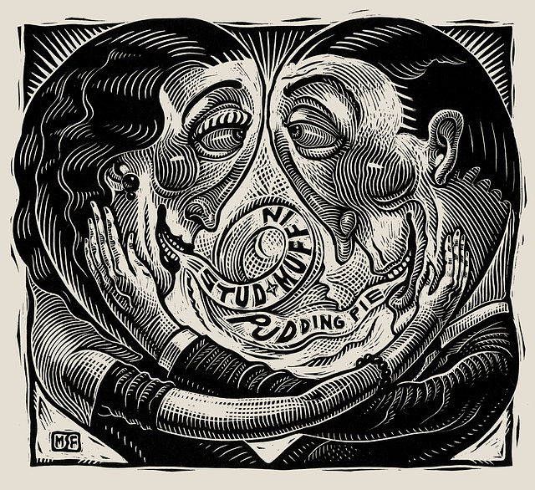

Slide 26
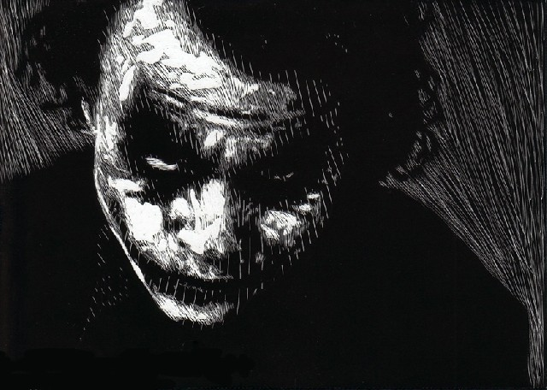

Slide 29
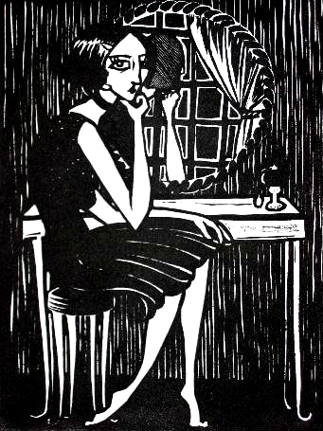

Slide 31
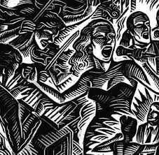

Slide 33
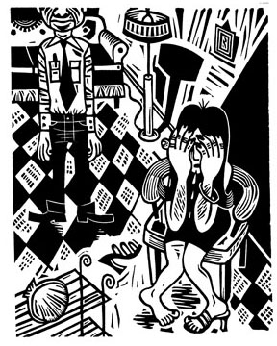

Slide 36
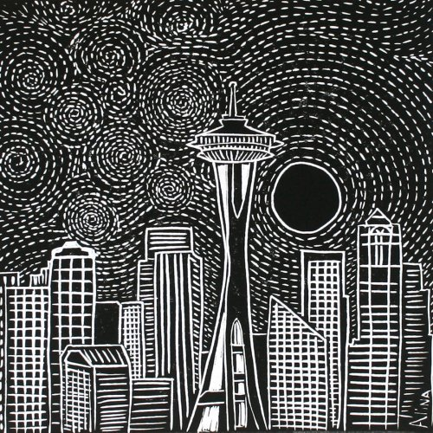

Slide 39
